Slide 1
SC1004 Part 2
Lectured by Prof Guan Cuntai
(teaching materials by Prof Chng Eng Siong)
Email: ctguan@ntu.edu.sg

Slide 2
Quiz 2 and Exam:
Quiz 2
- Coverage : Ch 6 ,7, 8 - Time/Date: Week 13, last lecture time (10:30-11.20am, 17th April 2024)
2. Final Exam
- Coverage : Ch 6, 7, 8 (Q3 & Q4)
- Date/Time: 2 May 2024 (Thursday), 1.00-3.00pm
(Ch 9 will not be tested)

Slide 3
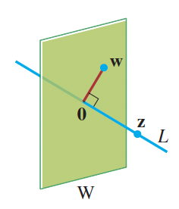
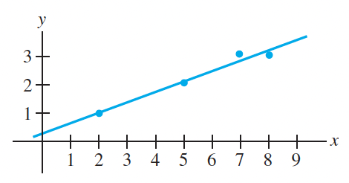
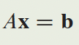
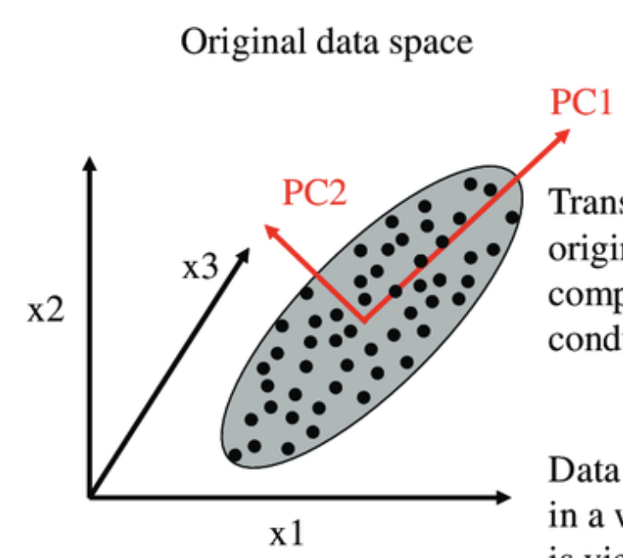
Syllabus for Part 2
Chapter | Topics | Week (Lecture) | Week (Tut)
6 | Orthogonality | 8-9 | 9-10
7 | Least Squares | 9-10 | 10-11
8 | EigenValue and Eigenvectors | 11-12 | 12-13
9 | Singular Value Decomposition (SVD) | 13
Table 1: schedule

Slide 4
Online Video learning Schedule
https://www.youtube.com/channel/UCBzG5jg3huxiPkCt-Serrjw
Week | Part | Topic | Notes
8 | 6.1.1-6.2.3 | Orthogonality, Normalization, Dot-Product, Inequalities, | Lecture 1: 6.1.1 - 6.1.3 Lecture 2: 6.1.4 - 6.2.3
9 | 6.2.4-6.3.2 | Orthogonal/Orthonormal Sets, Basis, Gram Schmidt and QR Decomposition | Lecture 3: 6.2.4 Lecture 4: 6.2.5 – 6.3.2
10 | 7.1.1-7.2.1 | Least Squares and Normal Eqn, Projection Matrix, Applications | Lecture 5: 7.1.1 – 7.1.3 Lecture 6: 7.1.4 – 7.2.1
11 | 8.1.1-8.1.2 | Eigenvectors, Eigen-values, Characteristics Eqn | Lecture 7: 8.1.1 Lecture 8: 8.1.2
12 | 8.1.3-8.1.5 | Diagonalisation, Power of A, Change of basis | Lecture 9: 8.1.3 Lecture 10: 8.1.4 – 8.1.5
13 | 9.1.1-9.2 | Introduction to SVD and PCA (Not examined in quiz/exam) | Lecture 11: 9.1.1 – 9.2 Lecture 12: Quiz 2

Slide 5
How will we conduct the course?
Before the lectures, watch the videos according to the schedule in Table 1
You can watch past years zoom video recordings at
https://www.youtube.com/@linearalgebra1884/playlists?view=50&sort=dd&shelf_id=2
During lecture hours –
We will summarize the lectures and highlight the key points
Q&A.

Slide 6
References

Slide 7
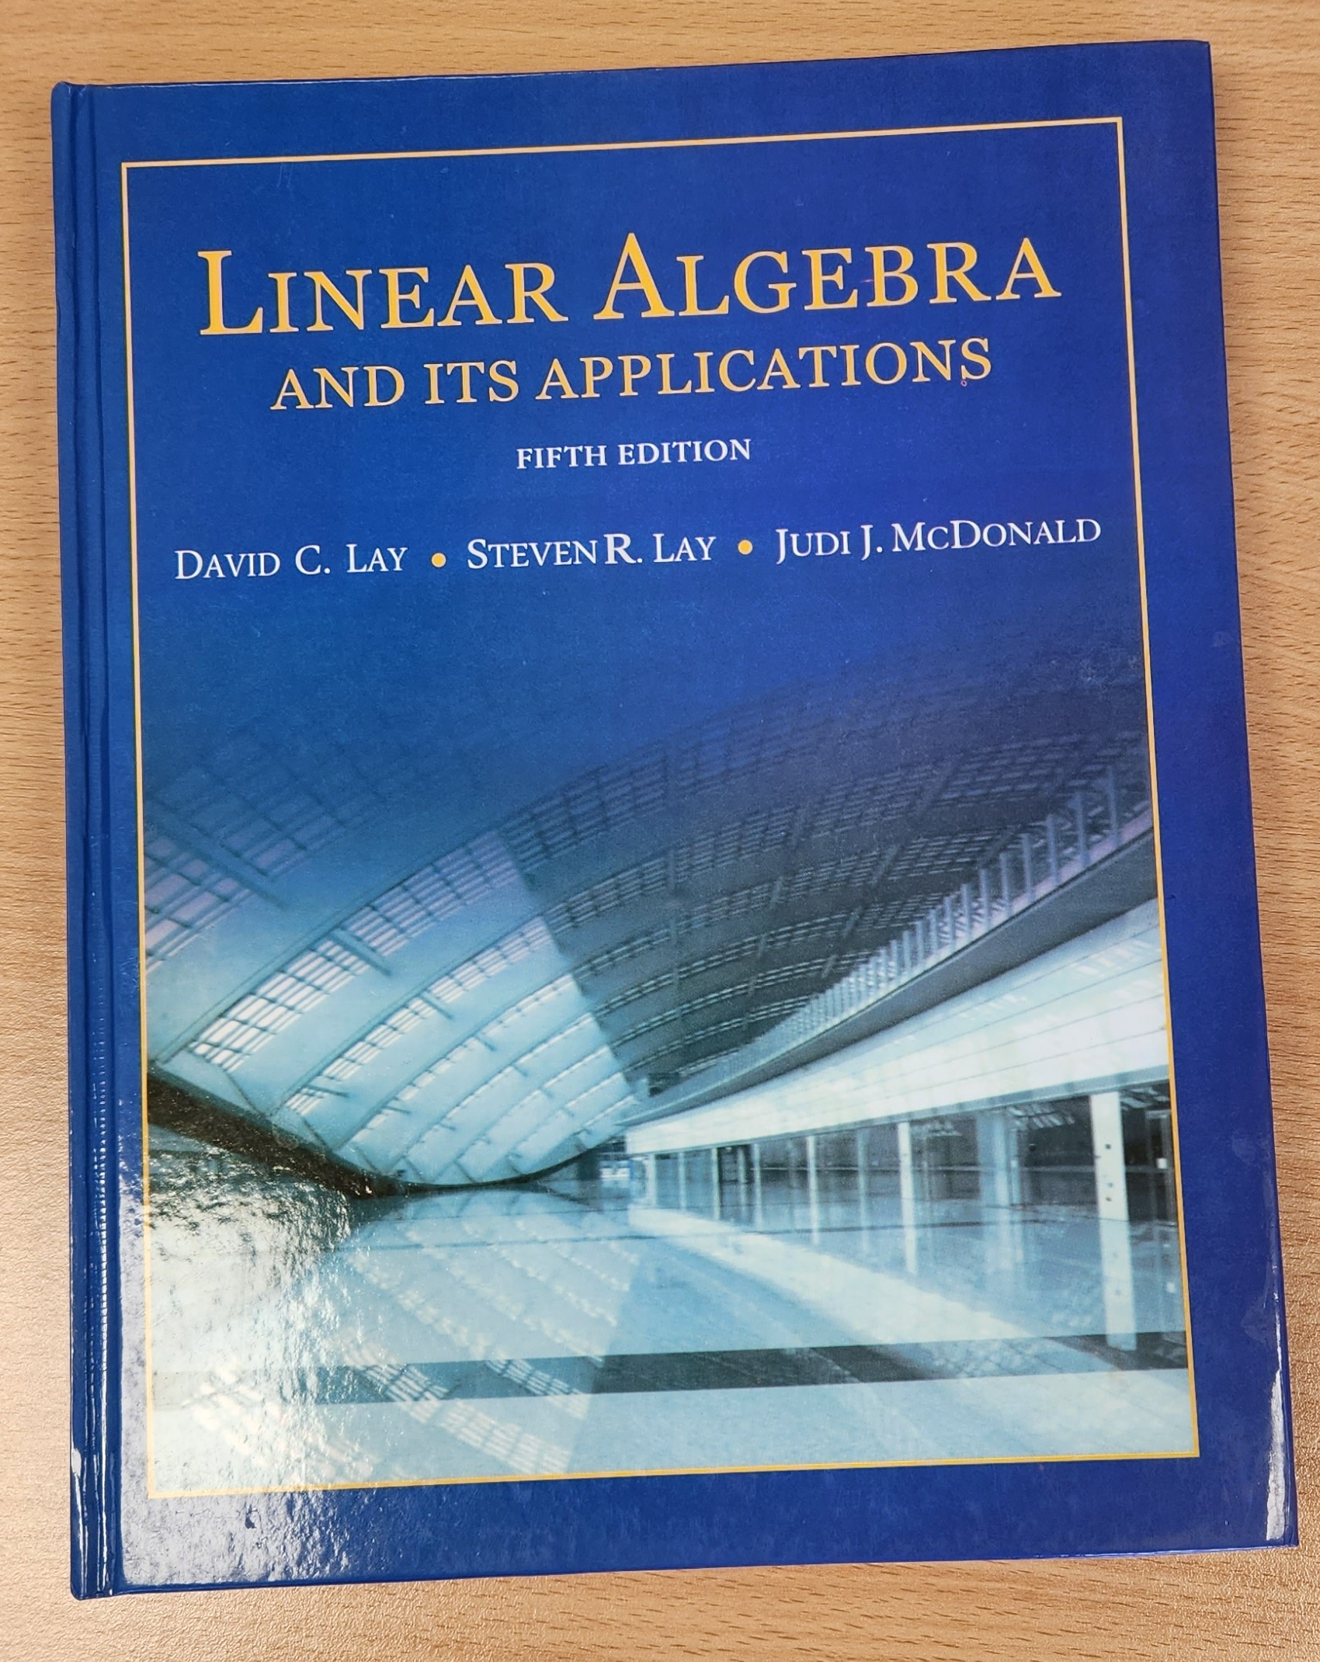

3Blue1Brown on YouTube
https://www.youtube.com/playlist?list=PLZHQObOWTQDPD3MizzM2xVFitgF8hE_ab
Linear Algebra and Its Applications
by David Lay, Steven Lay, Judi McDonald

Slide 8
Lecture (Week 10) (Chapter 7.1.1-7.2.1)

Slide 9
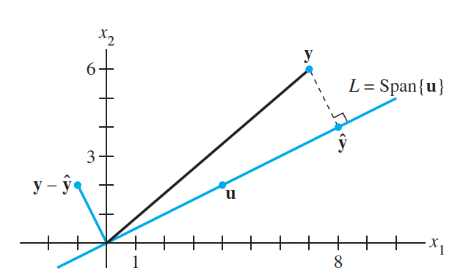
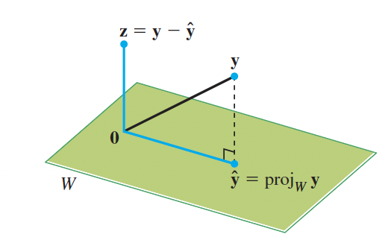
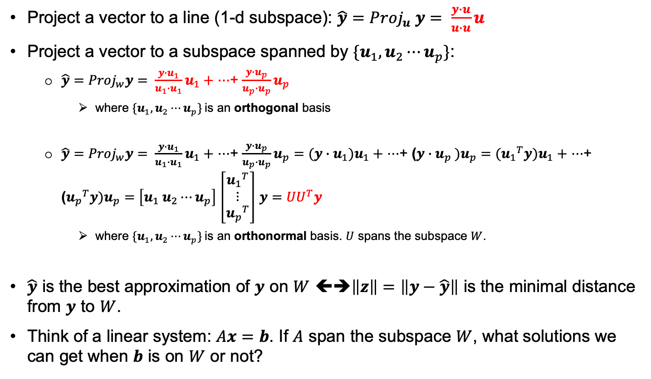
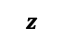
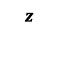
Key points – Ch 6: Orthogonal Projection
Revision
Project a vector to a line (1-d subspace): ${\hat{y}=Proj}_{u} y= \frac{y∙u}{u∙u}u$
Project a vector to a subspace spanned by ${\{u}_{1},u_{2}⋯u_{p}\}$:
${\hat{y}=Proj}_{w}y= \frac{y∙u_{1}}{u_{1}∙u_{1}}u_{1}+$ $⋯$+ $\frac{y∙u_{p}}{u_{p}∙u_{p}}u_{p}$
where ${\{u}_{1},u_{2}⋯u_{p}\}$is an orthogonal basis
${\hat{y}=Proj}_{w}y= \frac{y∙u_{1}}{u_{1}∙u_{1}}u_{1}+$ $⋯$+ $\frac{y∙u_{p}}{u_{p}∙u_{p}}u_{p}=$ $(y∙u_{1})u_{1}+$ $⋯$+ ($y∙u_{p} )u_{p}=$ $({u_{1}}^{T}y)u_{1}+$ $⋯$+ (${u_{p}}^{T}y)u_{p}=$ $\left[u_{1} u_{2}⋯u_{p}\right]$ $\left[\begin{matrix}{u_{1}}^{T} \\ ⋮ \\ {u_{p}}^{T}\end{matrix}\right]$ $y={UU}^{T}y$
where ${\{u}_{1},u_{2}⋯u_{p}\}$is an orthonormal basis. $U$ spans the subspace $W$.
$\hat{y}$ is the best approximation of $y$ on $W$ ⬅➔$\left\|z\right\|=\left\|y−\hat{y}\right\|$ is the minimal distance from $y$ to $W$.
Think of a linear system: $Ax=b$. If $A$ span the subspace $W$, what solutions we can get when $b$ is on $W$ or not?
$$z$$
$$z$$

Slide 10
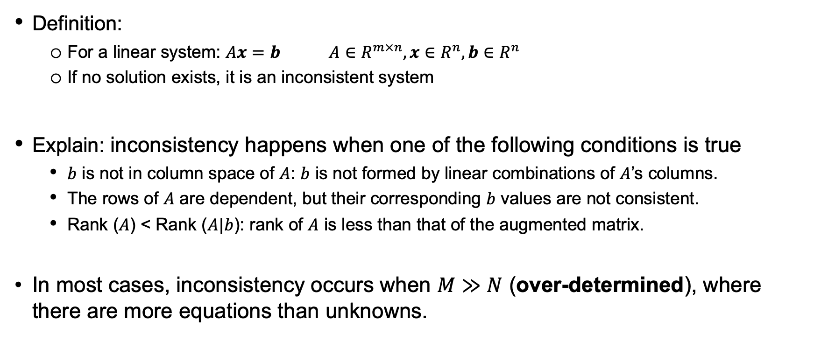
Key points – 7.1.1 Consistency in a System of Equations
Definition:
For a linear system: $Ax=b$ $A∈R^{m×n}, x∈R^{n},b∈R^{n}$
If no solution exists, it is an inconsistent system
Explain: inconsistency happens when one of the following conditions is true
$b$ is not in column space of $A$: $b$ is not formed by linear combinations of $A$’s columns.
The rows of $A$ are dependent, but their corresponding $b$ values are not consistent.
Rank ($A$) < Rank ($A|b$): rank of $A$ is less than that of the augmented matrix.
In most cases, inconsistency occurs when $M≫N$ (over-determined), where there are more equations than unknowns.
Notes:
𝑏 is not in column space of 𝐴: The column space of a matrix 𝐴 is the set of all possible vectors that can be obtained by taking linear combinations of its columns. If 𝑏 is not in the column space of 𝐴, it means that there is no set of coefficients (or weights) that you can assign to the columns of 𝐴 to get 𝑏. In other words, there is no solution to the equation 𝐴𝑥 = 𝑏.
The rows of 𝐴 are dependent, but their corresponding 𝑏 values are not consistent: If the rows of matrix 𝐴 are linearly dependent, it means that one or more rows can be expressed as a linear combination of others. In such a case, for a system to have a solution, the equations represented by these rows must require the same combination to be true of 𝑏. If they don't, the system is inconsistent because the same linear relationship does not apply to 𝑏.
Rank (𝐴) < Rank (𝐴|𝑏): The rank of a matrix 𝐴 is the dimension of the column space of 𝐴, or the maximum number of linearly independent columns of 𝐴. When you augment 𝐴 with 𝑏 (placing 𝑏 as an extra column to the right of 𝐴), you get a new matrix (𝐴|𝑏). If adding 𝑏 increases the rank, it means 𝑏 was outside of the column space of 𝐴, which implies that there are more independent conditions than variables to satisfy, leading to an inconsistent system.

Slide 11
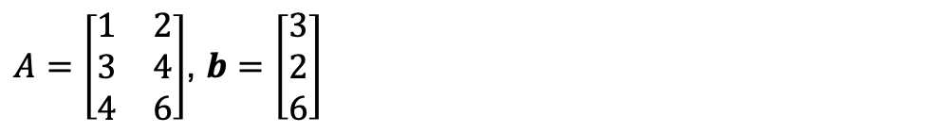
Example of an inconsistent system
$A=\left[\begin{matrix}1 & 2 \\ 3 & 4 \\ 4 & 6\end{matrix}\right]$, $b=\left[\begin{matrix}3 \\ 2 \\ 6\end{matrix}\right]$

Slide 12
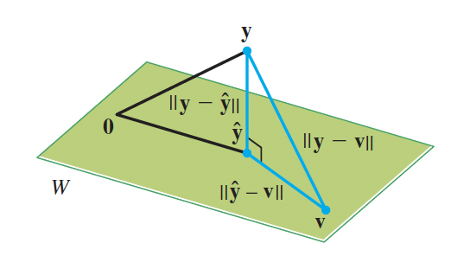
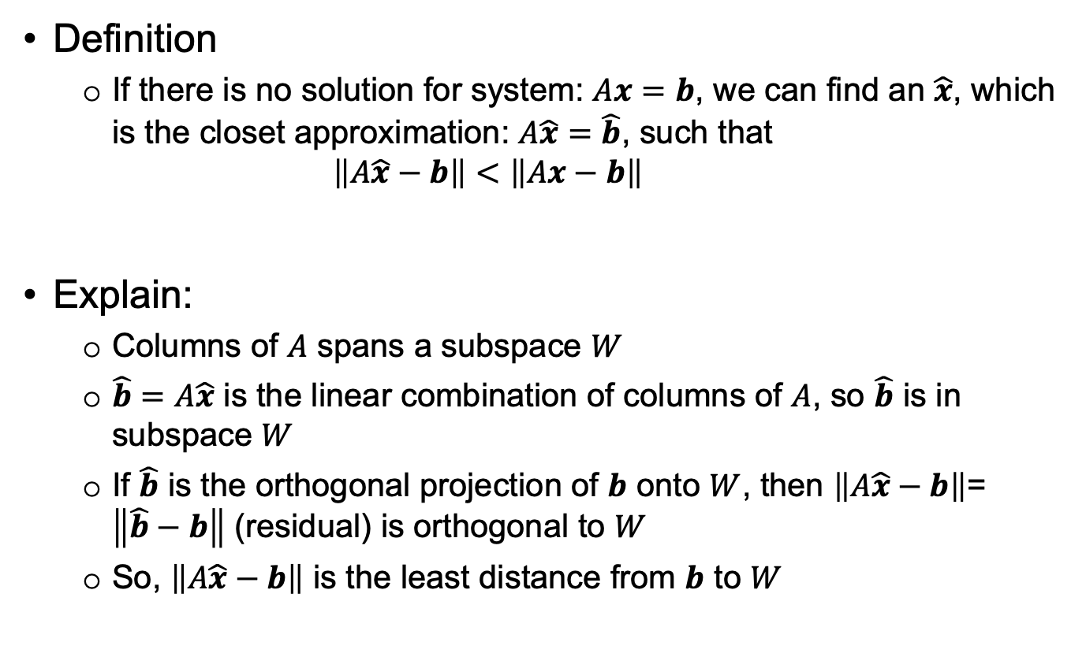
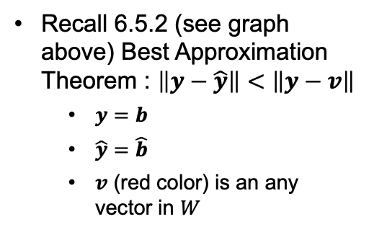
Key points – 7.1.2 The Least Square Problem
Definition
If there is no solution for system: $Ax=b$, we can find an $\hat{x}$, which is the closet approximation: $A\hat{x}$ $=\hat{b}$, such that
$$\left\|A\hat{x}−b\right\|<\left\|Ax−b\right\|$$
Explain:
Columns of $A$ spans a subspace $W$
$\hat{b}=A\hat{x}$ is the linear combination of columns of $A$, so $\hat{b}$ is in subspace $W$
If $\hat{b}$ is the orthogonal projection of $b$ onto $W$, then $\left\|A\hat{x}−b\right\|$= $\left\|\hat{b}−b\right\|$ (residual) is orthogonal to $W$
So, $\left\|A\hat{x}−b\right\|$ is the least distance from $b$ to $W$
Recall 6.5.2 (see graph above) Best Approximation Theorem : $\left\|y−\hat{y}\right\|<\left\|y−v\right\|$
$y=b$
$\hat{y}$ $=\hat{b}$
$v$ (red color) is an any vector in $W$

Slide 13


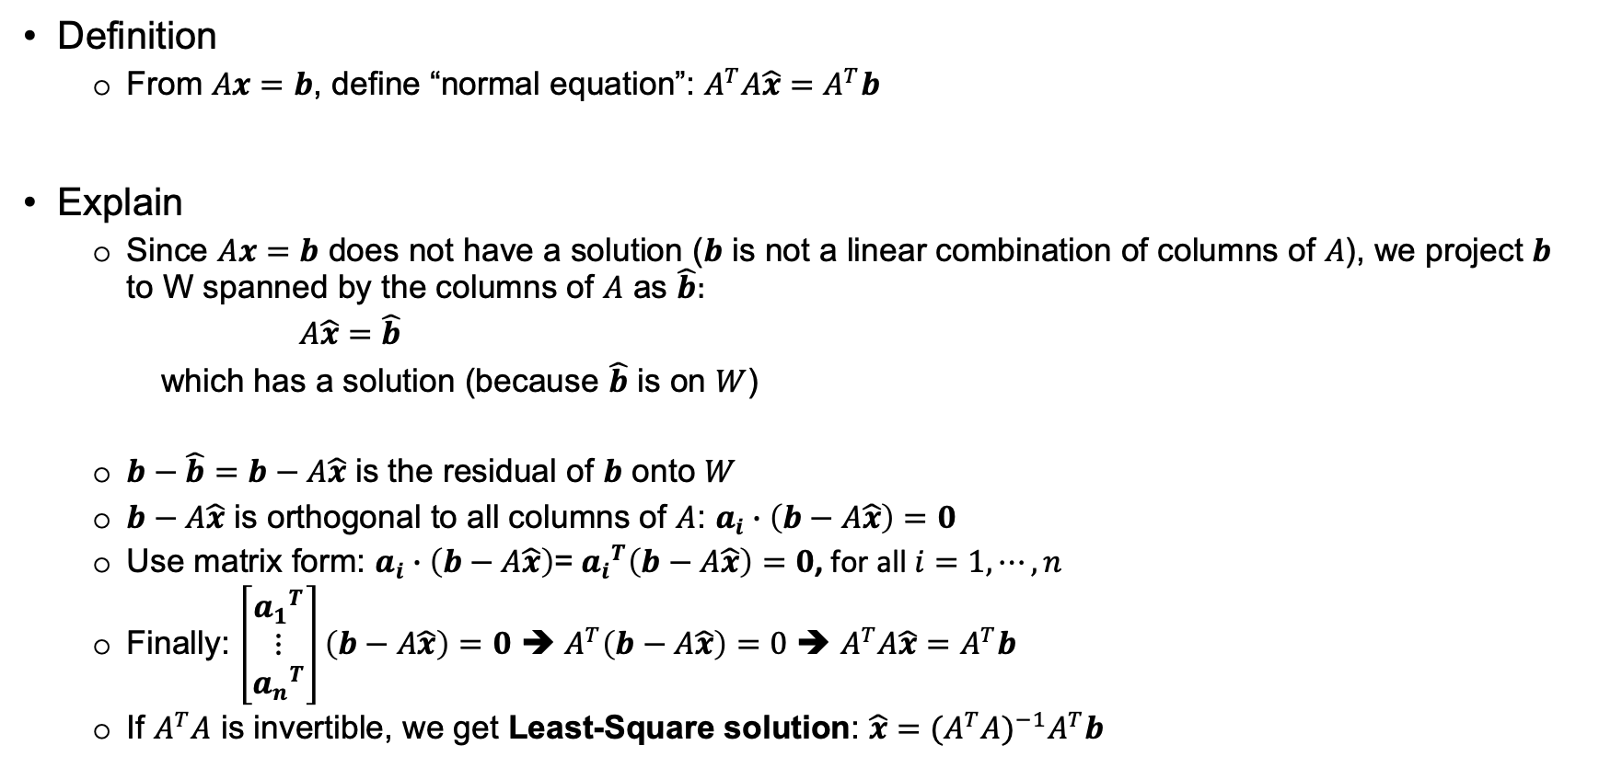

Key points – 7.1.3 Norm Equation (LS Solution)
Definition
From $Ax=b$, define “normal equation”: $A^{T}A\hat{x}=A^{T}b$
Explain
Since $Ax=b$ does not have a solution ($b$ is not a linear combination of columns of $A$), we project $b$ to W spanned by the columns of $A$ as $\hat{b}:$
$A\hat{x}$ $=\hat{b}$
which has a solution (because $\hat{b}$ is on $W$)
$b−\hat{b}=b−A\hat{x}$ is the residual of $b$ onto $W$
$b−A\hat{x}$ is orthogonal to all columns of $A$: $a_{i}∙\left(b−A\hat{x}\right)=0$
Use matrix form: $a_{i}∙\left(b−A\hat{x}\right)$= ${a_{i}}^{T}\left(b−A\hat{x}\right)=0$, for all $i=1,⋯,n$
Finally: $\left[\begin{matrix}{a_{1}}^{T} \\ ⋮ \\ {a_{n}}^{T}\end{matrix}\right]\left(b−A\hat{x}\right)=0$ ➔ $A^{T}\left(b−A\hat{x}\right)=0$ ➔ $A^{T}A\hat{x}=A^{T}b$
If $A^{T}A$ is invertible, we get Least-Square solution: $\hat{x}={(A^{T}A)}^{−1}A^{T}b$
$$A=\left[\begin{matrix}a_{1} & a_{2} & ⋯\end{matrix} \begin{matrix}a_{i} & ⋯ & a_{n}\end{matrix}\right]$$
$$A∈R^{m×n},a_{i}∈R^{m}$$
This Least-Square solution is derived from the normal equation directly.

Slide 14
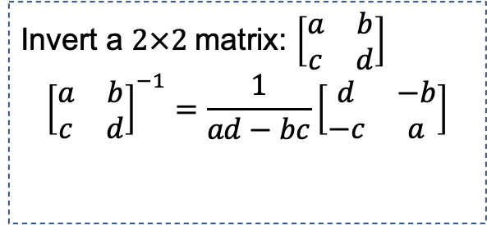
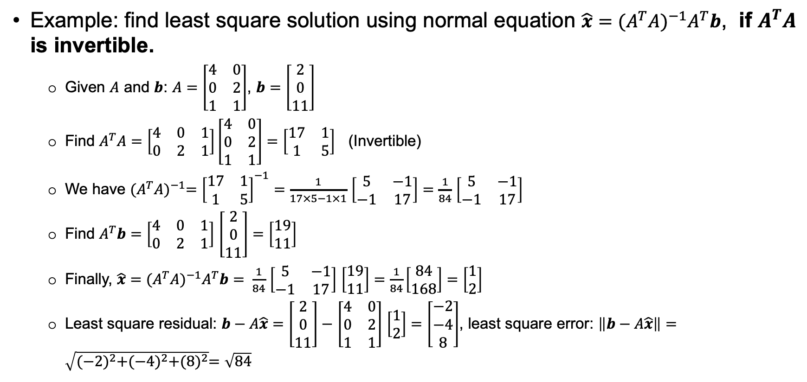
Key points – 7.1.3 Find Least Square Solution
Example: find least square solution using normal equation $\hat{x}={(A^{T}A)}^{−1}A^{T}b$, if $A^{T}A$ is invertible.
Given $A$ and $b$: $A=\left[\begin{matrix}4 & 0 \\ 0 & 2 \\ 1 & 1\end{matrix}\right]$, $b=\left[\begin{matrix}2 \\ 0 \\ 11\end{matrix}\right]$
Find $A^{T}A=$ $\left[\begin{matrix}4 & 0 & 1 \\ 0 & 2 & 1\end{matrix}\right]\left[\begin{matrix}4 & 0 \\ 0 & 2 \\ 1 & 1\end{matrix}\right]=\left[\begin{matrix}17 & 1 \\ 1 & 5\end{matrix}\right]$ (Invertible)
We have ${(A^{T}A)}^{−1}={\left[\begin{matrix}17 & 1 \\ 1 & 5\end{matrix}\right]}^{−1}=$ $\frac{1}{17×5−1×1}$ $\left[\begin{matrix}5 & −1 \\ −1 & 17\end{matrix}\right]=$ $\frac{1}{84}$ $\left[\begin{matrix}5 & −1 \\ −1 & 17\end{matrix}\right]$
Find $A^{T}b=$ $\left[\begin{matrix}4 & 0 & 1 \\ 0 & 2 & 1\end{matrix}\right]$ $\left[\begin{matrix}2 \\ 0 \\ 11\end{matrix}\right]=\left[\begin{matrix}19 \\ 11\end{matrix}\right]$
Finally, $\hat{x}={(A^{T}A)}^{−1}A^{T}b= \frac{1}{84}$ $\left[\begin{matrix}5 & −1 \\ −1 & 17\end{matrix}\right]$ $\left[\begin{matrix}19 \\ 11\end{matrix}\right]=\frac{1}{84}\left[\begin{matrix}84 \\ 168\end{matrix}\right]=$ $\left[\begin{matrix}1 \\ 2\end{matrix}\right]$
Least square residual: $b−A\hat{x}=$ $\left[\begin{matrix}2 \\ 0 \\ 11\end{matrix}\right]−$ $\left[\begin{matrix}4 & 0 \\ 0 & 2 \\ 1 & 1\end{matrix}\right]$ $\left[\begin{matrix}1 \\ 2\end{matrix}\right]=$ $\left[\begin{matrix}−2 \\ −4 \\ 8\end{matrix}\right]$, least square error: $\left\|b−A\hat{x}\right\|=\sqrt{{(−2)}^{2}+{(−4)}^{2}+{(8)}^{2}}=\sqrt{84}$
Invert a $2×2$matrix: $\left[\begin{matrix}a & b \\ c & d\end{matrix}\right]$
$${\left[\begin{matrix}a & b \\ c & d\end{matrix}\right]}^{−1}=\frac{1}{ad−bc}\left[\begin{matrix}d & −b \\ −c & a\end{matrix}\right]$$

Slide 15
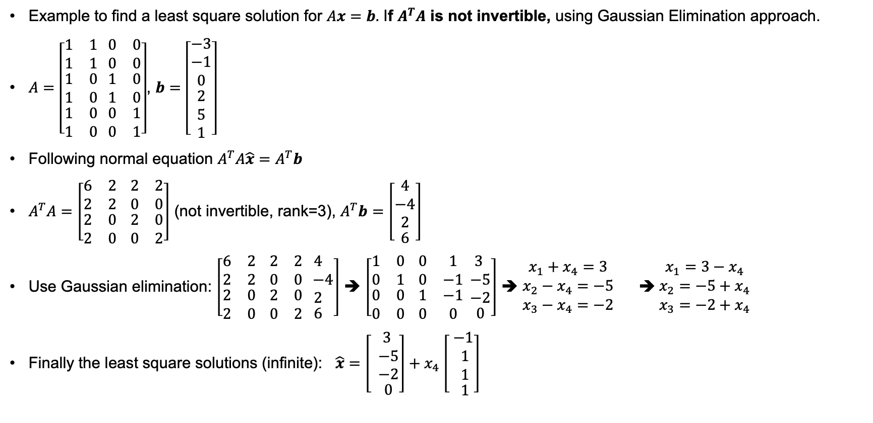
Key points – 7.1.3 Find Least Square Solution(2).
Example to find a least square solution for $Ax=b.$ If $A^{T}A$ is not invertible, using Gaussian Elimination approach.
$A=\left[\begin{aligned}\begin{matrix}1 & 1 \\ 1 & 1\end{matrix} \begin{matrix}0 & 0 \\ 0 & 0\end{matrix} \\ \begin{matrix}1 & 0 \\ 1 & 0\end{matrix} \begin{matrix}1 & 0 \\ 1 & 0\end{matrix} \\ \begin{matrix}1 & 0 \\ 1 & 0\end{matrix} \begin{matrix}0 & 1 \\ 0 & 1\end{matrix}\end{aligned}\right]$, $b=\left[\begin{aligned}\begin{matrix}−3 \\ −1 \\ 0\end{matrix} \\ \begin{matrix}2 \\ 5 \\ 1\end{matrix}\end{aligned}\right]$
Following normal equation $A^{T}A\hat{x}=A^{T}b$
$A^{T}A=\left[\begin{aligned}\begin{matrix}6 & 2 \\ 2 & 2\end{matrix} \begin{matrix}2 & 2 \\ 0 & 0\end{matrix} \\ \begin{matrix}2 & 0 \\ 2 & 0\end{matrix} \begin{matrix}2 & 0 \\ 0 & 2\end{matrix}\end{aligned}\right]$ (not invertible, rank=3), $A^{T}b=$ $\left[\begin{aligned}\begin{matrix}4 \\ −4 \\ 2\end{matrix} \\ 6\end{aligned}\right]$
Use Gaussian elimination: $\left[\begin{aligned}\begin{matrix}6 & 2 \\ 2 & 2\end{matrix} \begin{matrix}2 & 2 \\ 0 & 0\end{matrix} \\ \begin{matrix}2 & 0 \\ 2 & 0\end{matrix} \begin{matrix}2 & 0 \\ 0 & 2\end{matrix}\end{aligned}\begin{aligned}\begin{matrix}4 \\ −4 \\ 2\end{matrix} \\ 6\end{aligned}\right]$ ➔ $\left[\begin{aligned}\begin{matrix}1 & 0 \\ 0 & 1\end{matrix} \begin{matrix}0 & 1 \\ 0 & −1\end{matrix} \\ \begin{matrix}0 & 0 \\ 0 & 0\end{matrix} \begin{matrix}1 & −1 \\ 0 & 0\end{matrix}\end{aligned}\begin{aligned}\begin{matrix} 3 \\ −5 \\ −2\end{matrix} \\ 0\end{aligned}\right]$ ➔ $\begin{matrix}x_{1}+x_{4}=3 \\ x_{2}−x_{4}=−5 \\ x_{3}−x_{4}=−2\end{matrix}$ ➔ $\begin{matrix}x_{1}=3−x_{4} \\ x_{2}=−5+x_{4} \\ x_{3}=−2+x_{4}\end{matrix}$
Finally the least square solutions (infinite): $\hat{x}=$ $\left[\begin{aligned}\begin{matrix} 3 \\ −5 \\ −2\end{matrix} \\ 0\end{aligned}\right]+$ $x_{4}$ $\left[\begin{aligned}\begin{matrix} −1 \\ 1 \\ 1\end{matrix} \\ 1\end{aligned}\right]$

Slide 16
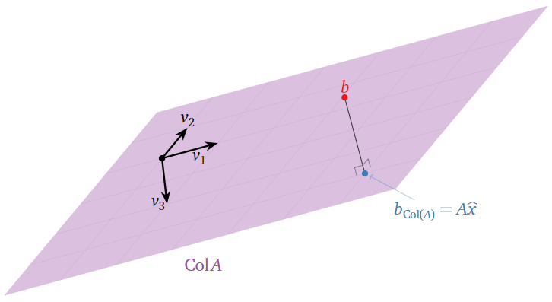
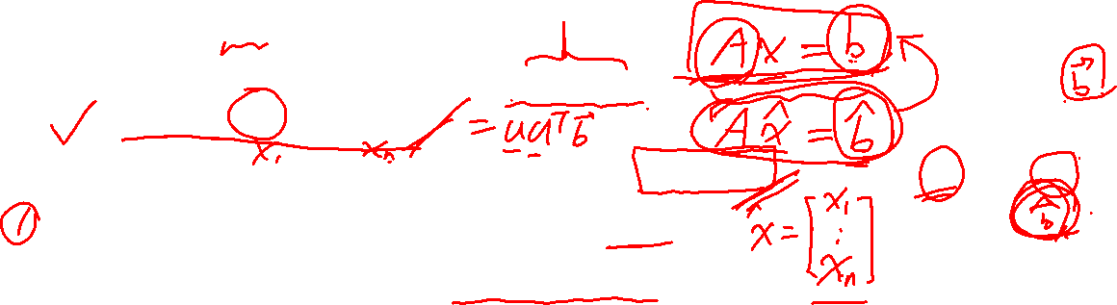
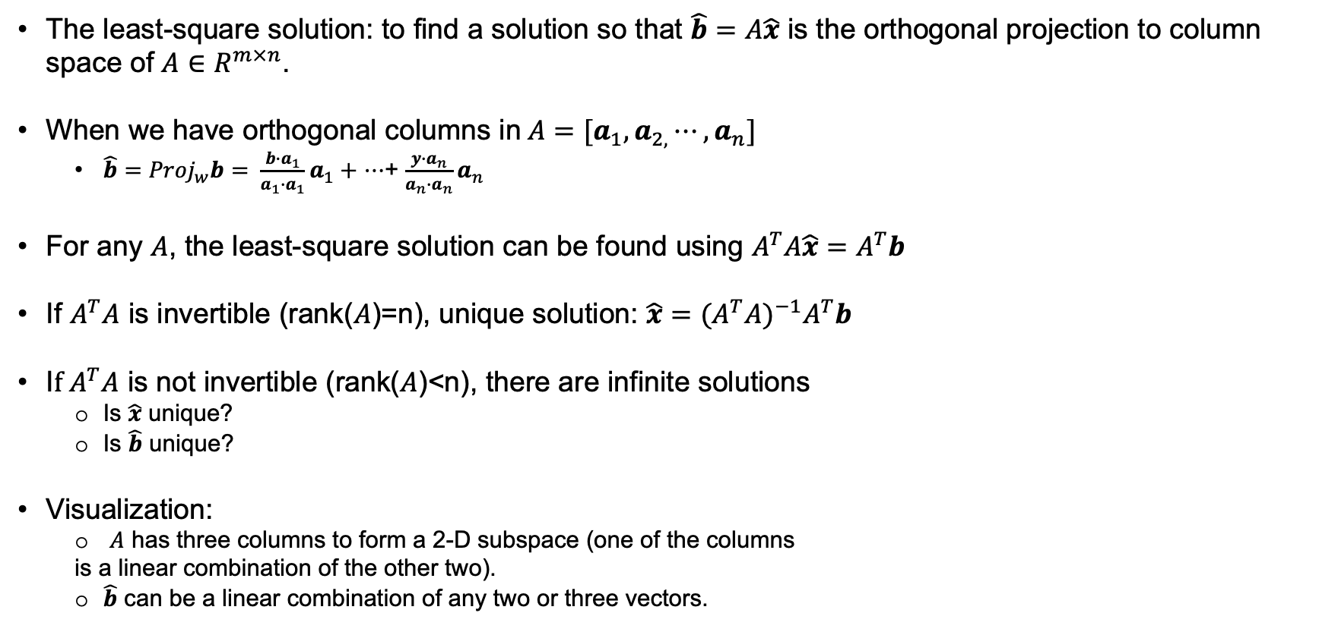

Comments on Least Square Solutions (so far)
The least-square solution: to find a solution so that $\hat{b}=A\hat{x}$ is the orthogonal projection to column space of $A∈R^{m×n}$.
When we have orthogonal columns in $A=[a_{1},a_{2,}⋯,a_{n}]$
${\hat{b}=Proj}_{w}b= \frac{b∙a_{1}}{a_{1}∙a_{1}}a_{1}+$ $⋯$+ $\frac{y∙a_{n}}{a_{n}∙a_{n}}a_{n}$
For any $A$, the least-square solution can be found using $A^{T}A\hat{x}=A^{T}b$
If $A^{T}A$ is invertible (rank($A$)=n), unique solution: $\hat{x}={(A^{T}A)}^{−1}A^{T}b$
I$f A^{T}A$ is not invertible (rank($A$)<n), there are infinite solutions
Is $\hat{x}$ unique?
Is $\hat{b}$ unique?
Visualization:
$A$ has three columns to form a 2-D subspace (one of the columns
is a linear combination of the other two).
$\hat{b}$ can be a linear combination of any two or three vectors.
$$z$$
$$\hat{b}$$

Slide 17
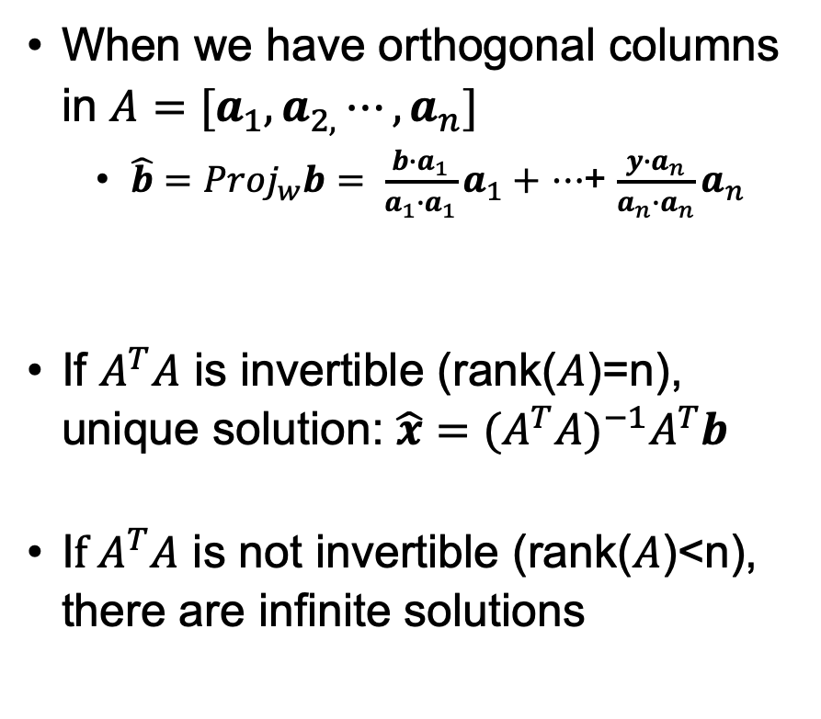
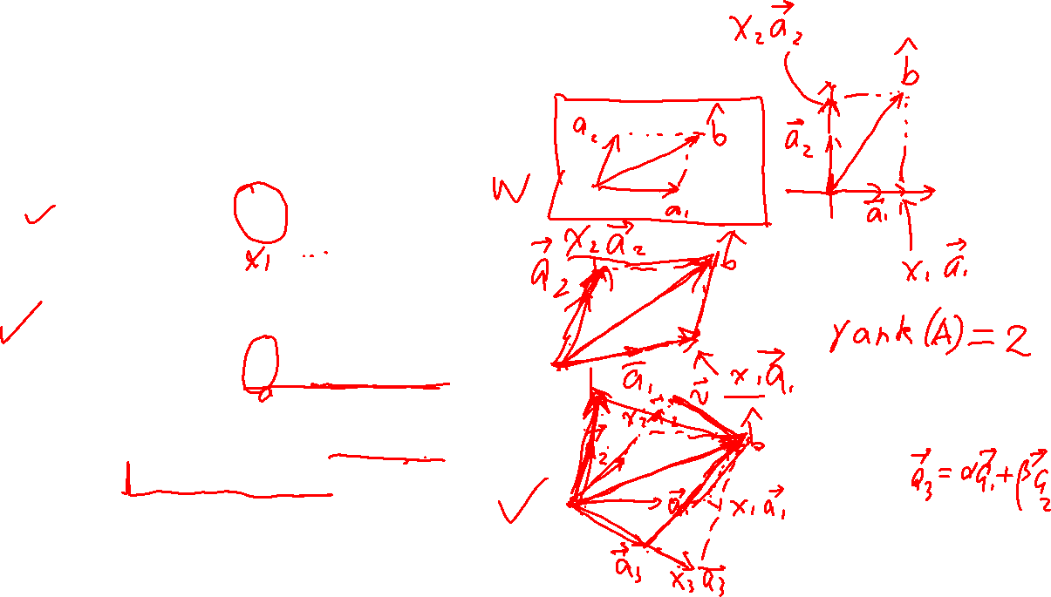
Visualize Least Square Solutions
When we have orthogonal columns in $A=[a_{1},a_{2,}⋯,a_{n}]$
${\hat{b}=Proj}_{w}b= \frac{b∙a_{1}}{a_{1}∙a_{1}}a_{1}+$ $⋯$+ $\frac{y∙a_{n}}{a_{n}∙a_{n}}a_{n}$
If $A^{T}A$ is invertible (rank($A$)=n), unique solution: $\hat{x}={(A^{T}A)}^{−1}A^{T}b$
I$f A^{T}A$ is not invertible (rank($A$)<n), there are infinite solutions

Slide 18
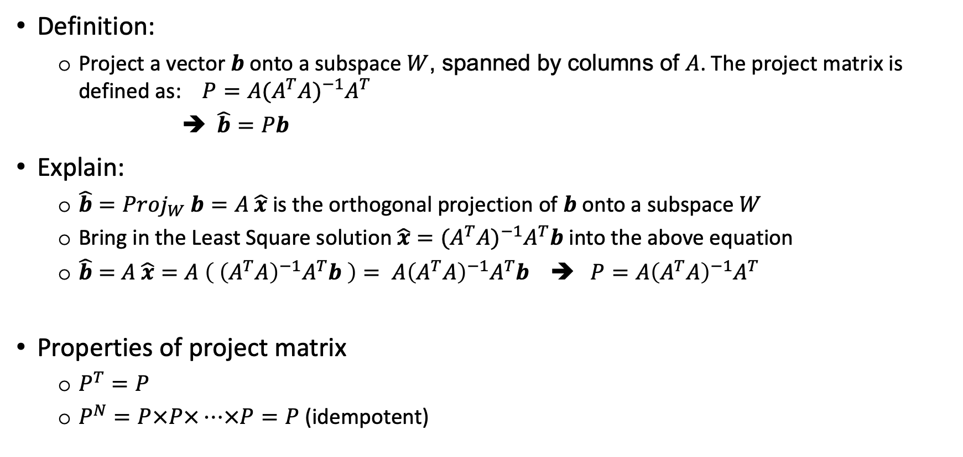
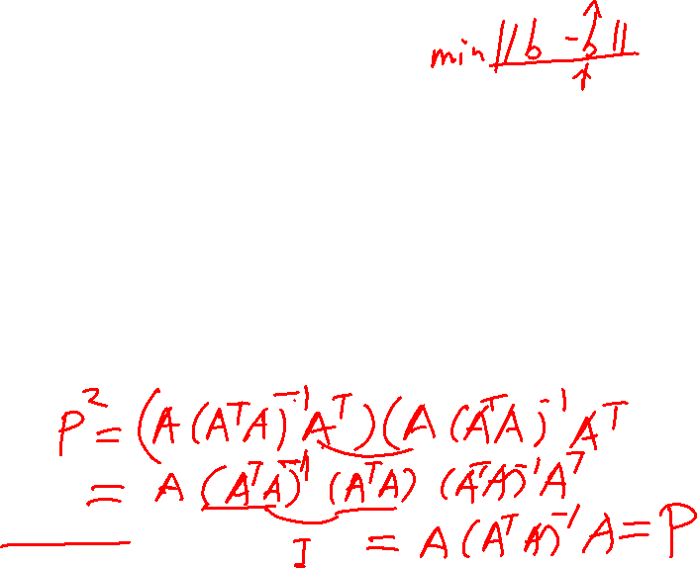
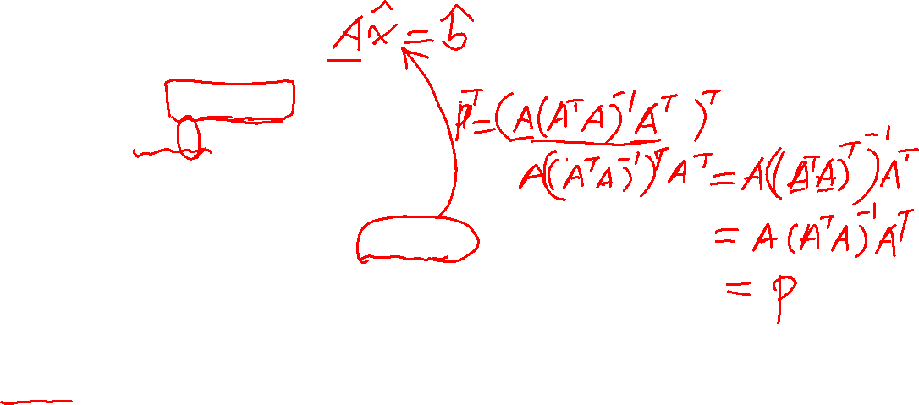
Key points – 7.1.4 Projection Matrix
Definition:
Project a vector $b$ onto a subspace $W$, spanned by columns of $A$. The project matrix is defined as: ${P=A(A^{T}A)}^{−1}A^{T}$
➔ $\hat{b}=Pb$
Explain:
$\hat{b}={Proj}_{W}$ $b=A \hat{x}$ is the orthogonal projection of $b$ onto a subspace $W$
Bring in the Least Square solution $\hat{x}={(A^{T}A)}^{−1}A^{T}b$ into the above equation
$\hat{b}=$ $A$ $\hat{x}=A \left( {\left(A^{T}A\right)}^{−1}A^{T}b \right)= A{\left(A^{T}A\right)}^{−1}A^{T}b$ ➔ $P=A{\left(A^{T}A\right)}^{−1}A^{T}$
Properties of project matrix
$P^{T}=P$
$P^{N}=P×P×⋯×P=P$ (idempotent)

Slide 19
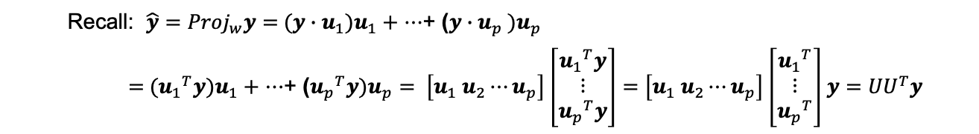
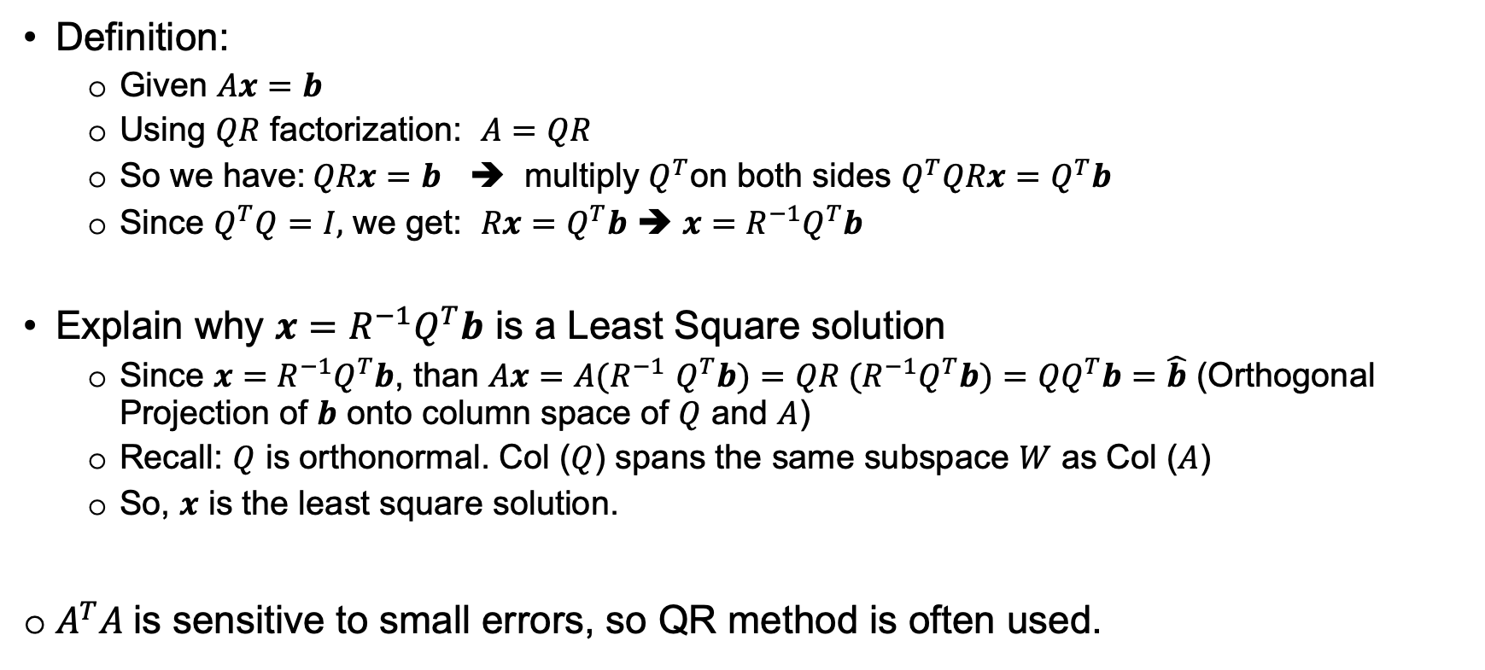
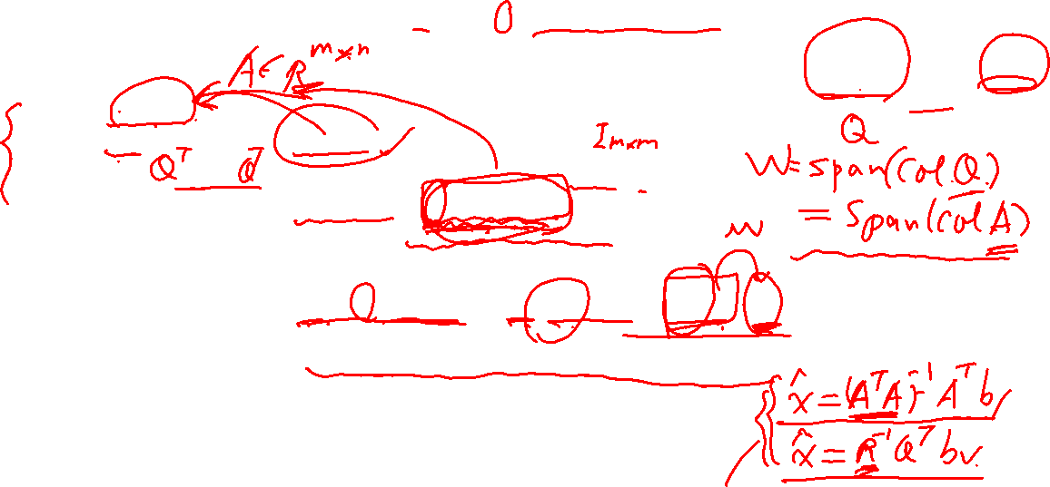
Key points – 7.1.5 Least Square Solution Using QR Factorization
Recall: ${\hat{y}=Proj}_{w}y=$ $(y∙u_{1})u_{1}+$ $⋯$+ ($y∙u_{p} )u_{p}$
$=$ $({u_{1}}^{T}y)u_{1}+$ $⋯$+ (${u_{p}}^{T}y)u_{p}= \left[u_{1} u_{2}⋯u_{p}\right]$ $\left[\begin{matrix}{u_{1}}^{T}y \\ ⋮ \\ {u_{p}}^{T}y\end{matrix}\right]=$ $\left[u_{1} u_{2}⋯u_{p}\right]$ $\left[\begin{matrix}{u_{1}}^{T} \\ ⋮ \\ {u_{p}}^{T}\end{matrix}\right]$ $y={UU}^{T}y$
Definition:
Given $Ax=b$
Using $QR$ factorization: $A=QR$
So we have:$QRx=b$ ➔ multiply $Q^{T}$on both sides $Q^{T}QRx=Q^{T}b$
Since $Q^{T}Q=I,$ we get: $Rx=Q^{T}b$ ➔ $x=R^{−1}Q^{T}b$
Explain why $x=R^{−1}Q^{T}b$ is a Least Square solution
Since $x=R^{−1}Q^{T}b$, than $Ax$ ${=A(R}^{−1}Q^{T}b)=$ ${QR (R}^{−1}Q^{T}b)=$ ${QQ}^{T}b=\hat{b}$ (Orthogonal Projection of $b$ onto column space of $Q$ and $A$)
Recall: $Q$ is orthonormal. Col ($Q$) spans the same subspace $W$ as Col ($A$)
So, $x$ is the least square solution.
$A^{T}A$is sensitive to small errors, so QR method is often used.

Slide 20
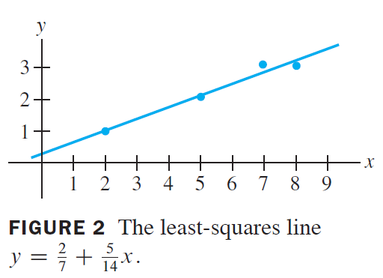

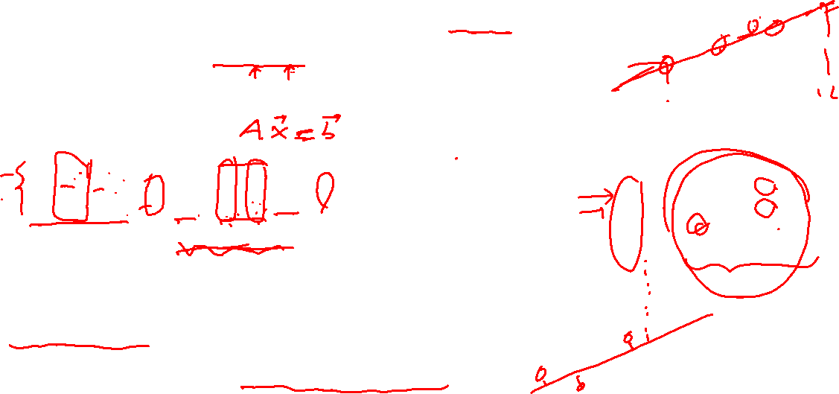
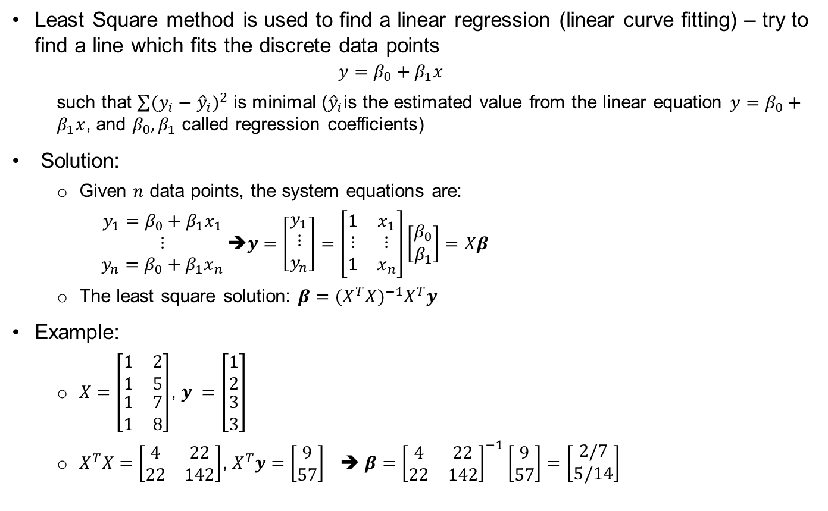
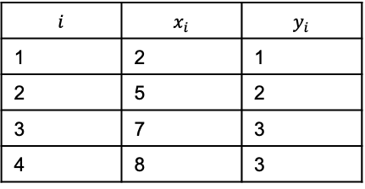
Key points – 7.2.1 Applications of Least Square
Least Square method is used to find a linear regression (linear curve fitting) – try to find a line which fits the discrete data points
$$y=β_{0}+β_{1}x$$
such that $\sum{{(y_{i}−{\hat{y}}_{i})}^{2}}$ is minimal (${\hat{y}}_{i}$is the estimated value from the linear equation $y=β_{0}+β_{1}x$, and $β_{0}, β_{1}$ called regression coefficients)
Solution:
Given $n$ data points, the system equations are:
$\begin{matrix}y_{1}=β_{0}+β_{1}x_{1} \\ ⋮ \\ y_{n}=β_{0}+β_{1}x_{n}\end{matrix}$➔$y=\left[\begin{matrix}y_{1} \\ ⋮ \\ y_{n}\end{matrix}\right]=\left[\begin{matrix}1 & x_{1} \\ ⋮ & ⋮ \\ 1 & x_{n}\end{matrix}\right]\left[\begin{matrix}β_{0} \\ β_{1}\end{matrix}\right]=Xβ$
The least square solution: $β$ $={(X^{T}X)}^{−1}X^{T}y$
Example:
$X=\left[\begin{matrix}1 & 2 \\ 1 & 5 \\ \begin{aligned}1 \\ 1\end{aligned} & \begin{aligned}7 \\ 8\end{aligned}\end{matrix}\right]$, $y =\left[\begin{matrix}1 \\ 2 \\ \begin{aligned}3 \\ 3\end{aligned}\end{matrix}\right]$
$X^{T}X=\left[\begin{matrix}4 & 22 \\ 22 & 142\end{matrix}\right]$, $X^{T}y=$ $\left[\begin{matrix}9 \\ 57\end{matrix}\right]$ ➔ $β$ $={\left[\begin{matrix}4 & 22 \\ 22 & 142\end{matrix}\right]}^{−1}\left[\begin{matrix}9 \\ 57\end{matrix}\right]=$ $\left[\begin{matrix}2/7 \\ 5/14\end{matrix}\right]$
$$i$$ | $$x_{i}$$ | $$y_{i}$$
1 | 2 | 1
2 | 5 | 2
3 | 7 | 3
4 | 8 | 3
Recall: $\hat{x}={(A^{T}A)}^{−1}A^{T}b$

Slide 21
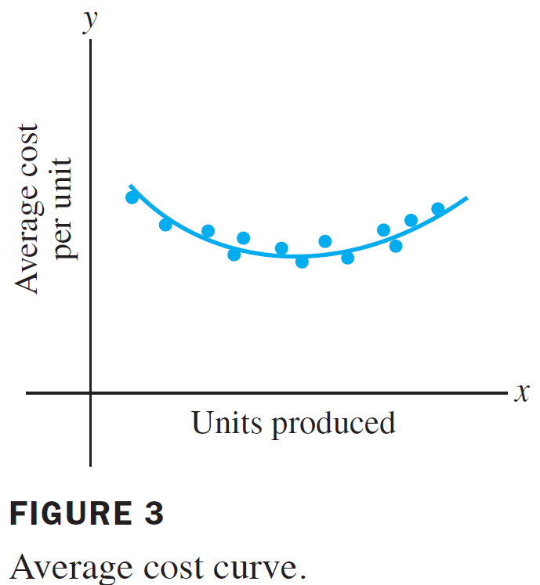
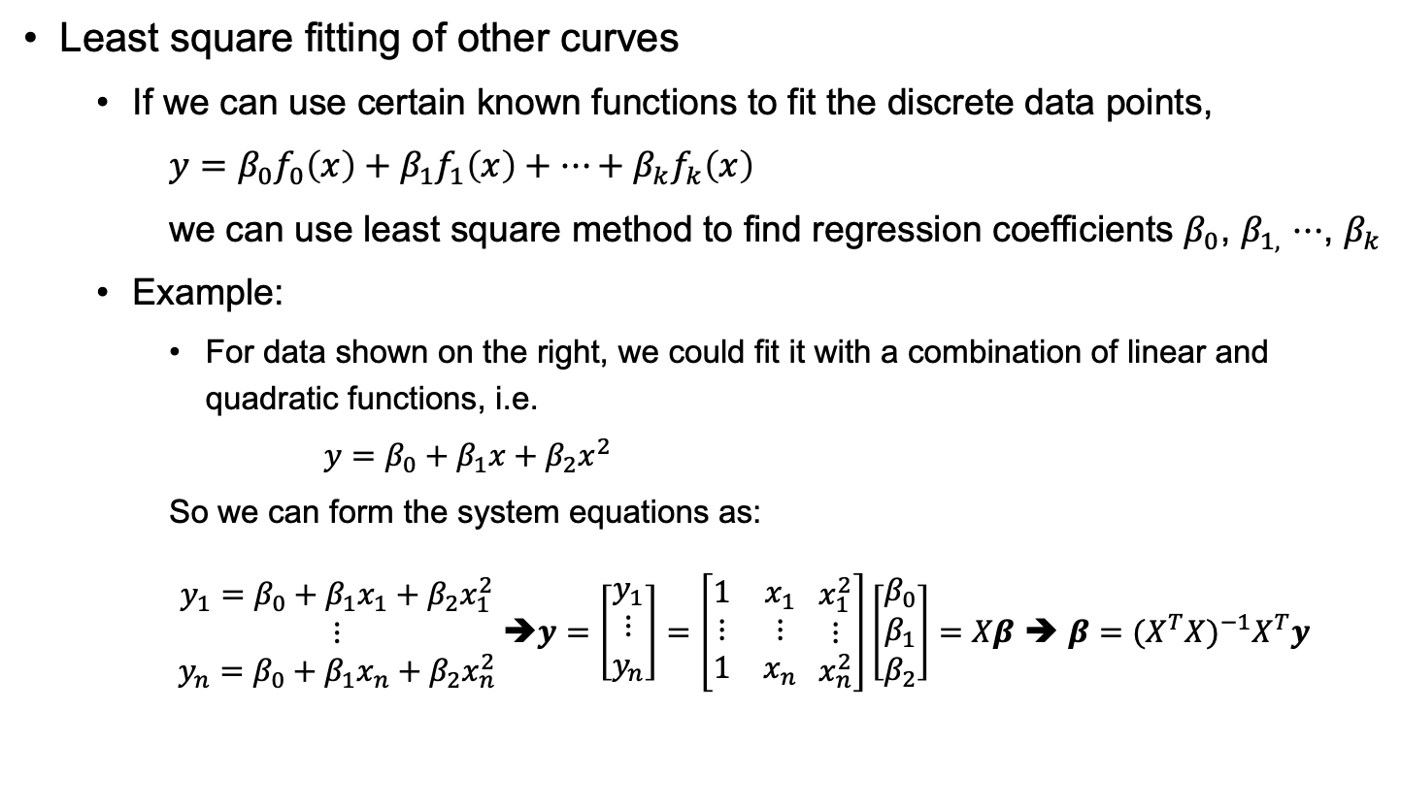
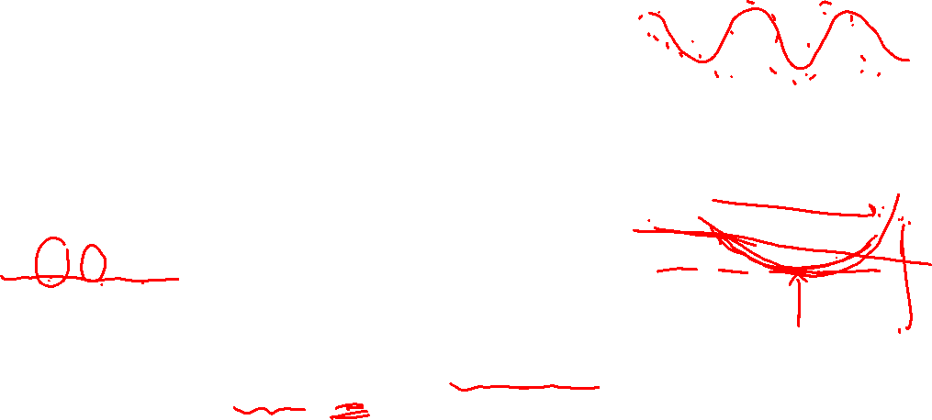
Key points – 7.2.1 Applications of Least Square (2)
Least square fitting of other curves
If we can use certain known functions to fit the discrete data points,
$y=β_{0}f_{0}\left(x\right)+β_{1}f_{1}\left(x\right)+⋯+β_{k}f_{k}\left(x\right)$
we can use least square method to find regression coefficients $β_{0}$, $β_{1,}$ $⋯$, $β_{k}$
Example:
For data shown on the right, we could fit it with a combination of linear and quadratic functions, i.e.
$y=β_{0}+β_{1}x+β_{2}x^{2}$
So we can form the system equations as:
$\begin{matrix}y_{1}=β_{0}+β_{1}x_{1}+β_{2}x_{1}^{2} \\ ⋮ \\ y_{n}=β_{0}+β_{1}x_{n}+β_{2}x_{n}^{2}\end{matrix}$➔$y=\left[\begin{matrix}y_{1} \\ ⋮ \\ y_{n}\end{matrix}\right]=\left[\begin{matrix}1 & x_{1} \\ ⋮ & ⋮ \\ 1 & x_{n}\end{matrix} \begin{matrix}x_{1}^{2} \\ ⋮ \\ x_{n}^{2}\end{matrix}\right]\left[\begin{matrix}β_{0} \\ \begin{aligned}β_{1} \\ β_{2}\end{aligned}\end{matrix}\right]=Xβ$ ➔ $β$ $={(X^{T}X)}^{−1}X^{T}y$

Slide 22
End

Slide 23

Additional notes:
Differences between LU and QR factorization
LU is applied to any square matrix, QR is applied to a matrix with independent columns
LU factorization produces an upper-triangle and a lower-triangle matrix
QR factorization produces an orthonormal matrix and an upper-triangle
Find LU factorization through Gaussian elimination
Find QR factorization using the Gram-Schmidt algorithm
Different use cases:
LU factorization is used to find solutions of systems of linear equations, matrix inversion, and matrix determinant.
QR factorization is used in least-squares, eigenvalue, and signal processing.
Notes:
LU Decomposition: 𝐴 = 𝐿𝐔
Usually, it is for square matrices (but it can be generalized to rectangular matrices as well)
Solving square systems of linear equations, inverting matrices, and calculating the determinant of square matrices.
QR Decomposition: 𝐴 = 𝐐𝐑.
QR decomposition It can be applied to both square and rectangular matrices.
Solving least squares problems, eigenvalue problems
Differences:
LU is typically used for square matrices and for systems where an exact solution exists.
QR can be used for any matrix size and is particularly useful for over-determined systems where no exact solution exists.
LU may require row interchanges (pivoting) for numerical stability.
QR is inherently more stable due to the use of orthogonal matrices.
LU is often used for systems where pivoting is not a significant issue and for direct methods of matrix inversion and determinant computation
QR is favored for solutions with least squares and is used in iterative algorithms to find eigenvalues.
The complexity of LU is generally lower than that of QR, making LU faster for direct-solve applications.
QR, while more computationally intensive, provides more robustness for problems that are sensitive to numerical errors.
LU is typically faster and used for systems that are well-conditioned and square, while QR is more robust and versatile, especially for least squares problems and eigenvalue computations.

